Slide 1
Christopher Hardy
Devops Engineer, SRE, QA Software Test Automation Engineer, Developer, Agile / Scrum Master Coach, and Project Manager

Slide 2
Hi, I’m Christopher Hardy
I’m passionate about building great products that make people’s lives easier. I have over 20 years innovating in the digital world with experiences in small and medium companies to the world’s biggest brands such as IBM Watson, and Nuance Health and many Defense Companies.
I grew up in Annapolis, MD, lived in New Jersey for some time, and now reside outside of Boston, MA. I am an avid walker / hiker, girl’s soccer coach, involved with various Town of Acton government committees, a Freemason, and father and husband of three fabulous women.

Slide 3
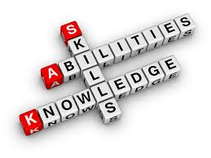
QA Automation
Devops / SRE
Software development
Project Management
Scrum Master / Agile Coach

Slide 4
Employment history
Devops Engineer / Project Manager / Agile Coach
Omni Federal
Kessel Run - Air Force
April 2020 - Present
Large Defense Companies as a Developer
CSC, Lockheed Martin, BAE
June 2001 - Month 2007
QA Automation Engineer
MIT Lincoln Laboratory, RSA, HealthEdge, Scholastic, IBM
September 2010 - May 2016
Software Security and Defect Analysis Engineer
InfoSec, ProServices
May 2007 - August 2010
Devops Engineer / SRE
IBM, Nuance
June 2016 - March 2020

Slide 5



How the Agile Process and Devops Culture utilizes Test Frameworks and the CI/CD workflow
CLICK HERE to see a quick presentation

Slide 6
Software Testing Automation Pyramid
CI
Developers - Dev
QA - Testops
Scans
CD
Deployment
Testing
Infrastructure
UI
Tests
End to End
Tests
Workflow
Tests
Acceptance / Behavioral Tests
Integration / Mock / Component Tests
Unit / Functional
Tests

Slide 7

Timing of specific kinds of testing
Continuous Integration ( CI ) - Each build this happens. If it all passes, we then can create docker type images to publish to a Repository such as Nexus.
Unit Testing - individual method / function tests
Static and Dynamic Analysis
Code Coverage - Identify lines of code not tested
Smoke Tests - quick tests, cover as much code as possible
Functional Tests - UI
Mock / Component / Integration Tests - API and Services
Nightly
Regression
Performance
Security
End to End

Slide 8
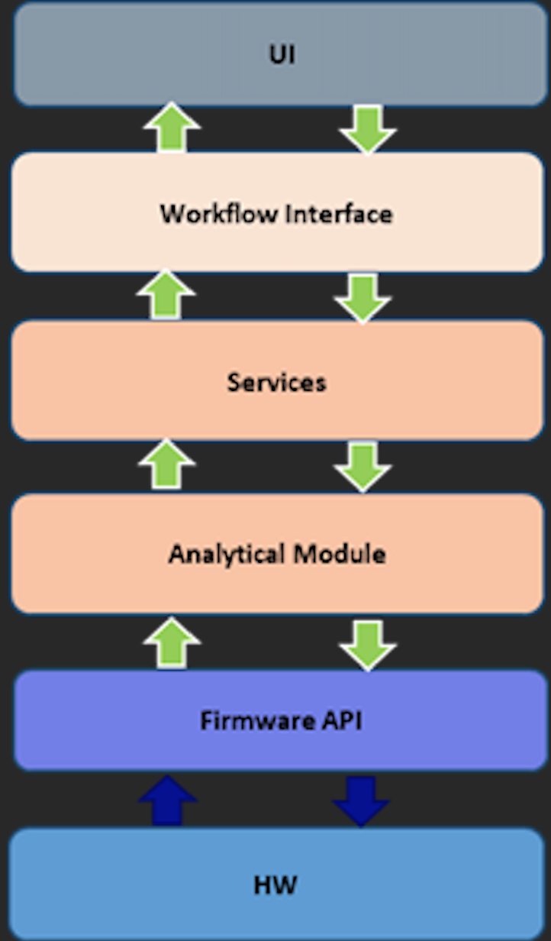
Widget Application
Design Architecture

Slide 9
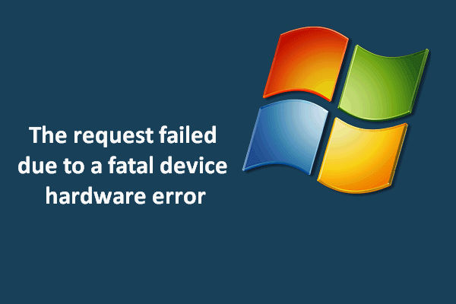
HW Failure / System Recovery Testing
Recovery testing is a type of system testing which aims at testing whether a system can recover from failures or not. The technique involves failing the system and then verifying that the system recovery is performed properly.

Slide 10

Deployment Health Check Testing
Kubernetes offers two kinds of health checks: the readinessProbe and the livenessProbe. Both of them use the same types of probes (HTTP GET requests, TCP connections, and command execution).
TCP is the default, specified as a TCP: port pair, for example "TCP:5000". A health check simply attempts to open a TCP connection to the instance on the specified port. Failure to connect within the configured timeout is considered unhealthy.

Slide 11
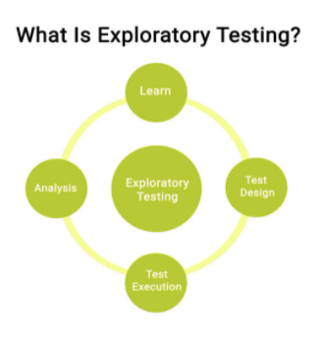
Exploratory and Manual
Testing
Exploratory testing is a form of software testing that is performed to establish the feasibility of a product. In other testing methods, which we’ll get to below, test cases are created in advance and then executed at a later stage. Whereas exploratory testing involves simultaneously designing and executing the test. Exploratory testers need to be able to think and take action quickly rather than follow laid out steps.

Slide 12

Education
Rowan University
Glassboro, NJ
B.S., Computer Science.: May 2001
Villanova University
Philadelphia, PA
Software Test Certificate: September 2010
Ocean County College
Toms River, NJ
A.S., General Engineering,: December 1996

Slide 13

Contact
Christopher Hardy
christopherhardy@gmail.com
(609) 636-8048

